Slide 1

Principles of Economics
Swagat Kishore Mishra
Lecturer, Dept. of Economics
Email: swagat@bits-goa.ac.in / sayswagat@gmail.com
VOIP: 207 PSRN: 485 CHAMBER: A-301/16
Tel. 0832-2580207 (O) 08879506995 (M)
Lecture-8

Slide 2
Contents
Consumer Surplus Vs. Producer Surplus
Economic Efficiency
Mathematical Interpretation
Case study: 1 and 2

Slide 3

Consumer Surplus (CS)
Consumer's surplus is a widely used tool in applied welfare economics.
Both economic theorists and cost benefit analysis often use consumer's surplus despite its somewhat dubious reputation.
The basic idea is to evaluate the value to a consumer or his "willingness to pay" for a change in price of a good from say price p0 to price p1.
Because price changes affect consumer welfare, an evaluation of this effect is often a key input to public policy decisions.

Slide 4
CS first conceptualized by Jules Dupit around 1844 and later popularized by Marshall.
CS was introduced by Marshall as a monetary measure equal to the difference between the amount of money that the consumer actually pays to buy a certain quantity of a commodity ‘X’ and the amount that he would be willing to pay for this quantity rather than do without it.
Marshall held that the MU of money income is constant.
Area under the demand curve measures CS or Demander’s Surplus. (Similarly area above the supply curve measures PS or Supplier’s Surplus)

Slide 5
Thus, the benefit surplus received by a consumer or consumers in a market is called consumer surplus .
i.e. the difference between the maximum price a consumer is (or consumers are) willing to pay for a product and the actual price.
The reason behind this phenomena is due to the utility surplus on account of all consumers paying the equilibrium price even though many would be willing to pay more than that price to obtain the product.
A. Consumer surplus is the difference between the value to buyers of a level of consumption of a good and the amount the buyers must pay to get that amount.
B. Consumer surplus is the welfare consumers get from the good.

Slide 6
Example 1:
Consumer surplus can be estimated from the demand curve for a good.
Graph (a) shows the demand curve for pizza, and Q* pizzas are being consumed. Suppose that pizzas sell for P*, the highest price that could be charged for Q*. The value consumers place on consuming Q* is the area A+B. But consumers pay only P* for each pizza, paying P* times Q* in all. Consumers get a value A+B at a cost of B. The area A is the consumer surplus.
PRICE
A
P*
B
D
QUANTITY
O
Q*

Slide 7
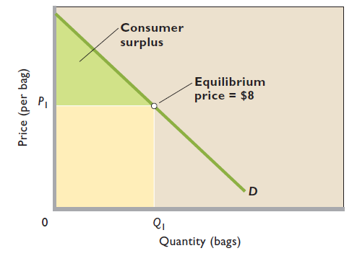
EXAMPLE 2:
The demand curve shows the buyers’ maximum willingness to pay for each unit of the product and we assume that the equilibrium price, P 1 , of oranges is $8 per bag. The portion of the demand curve D lying above the $8 equilibrium price shows that many consumers of oranges would be willing to pay more than $8 per bag rather than go without oranges.

Slide 8
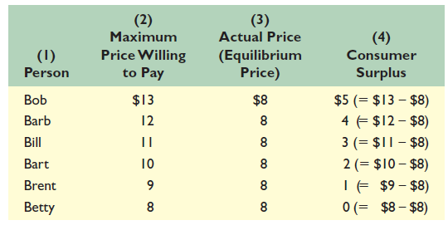
CS for individuals is depicted in the table below:

Slide 9
Consumer surplus and price are inversely (negatively) related.
i.e. Given the demand curve, higher prices reduce consumer surplus; lower prices increase it.

Slide 10
Producer Surplus (PS)
Producer surplus is the welfare sellers get from selling a good.
Producer surplus is the difference between the revenue sellers take in from sale of a good and the minimum amount they would accept to produce it.
In a competitive market, producer surplus can be estimated from a good’s supply curve.
Like consumers, producers also receive a benefit surplus in markets.
i.e. producer surplus is the difference between the actual price a producer receives (or producers receive) and the minimum acceptable price.

Slide 11
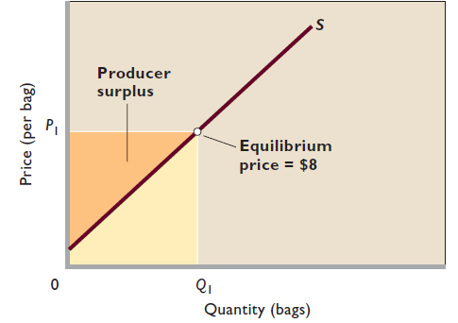
Producer surplus—shown as the orange triangle—is the differences between the actual price producers receive for a product (here $8) and the lower minimum payments they are willing to accept. For quantity Q 1 , producers receive the sum of the amounts represented by the orange triangle plus the tan area.
Because they need to receive only the amount shown by the tan area to produce Q1, the orange triangle represents producer surplus.

Slide 12

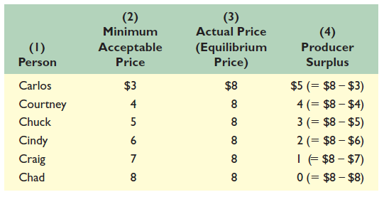

Slide 13
Example 3:
The supply curve shows the seller’s minimum acceptable price at each unit of the product.
Graph (b) shows the supply curve for pizza, and Q* pizzas are being sold. Suppose pizzas sell for P*, the lowest price that would induce sellers to sell Q*. Pizza firms have receipts of Q* times P* (area C + D), but would be willing to sell Q* for an amount equal to area D. The producer surplus is area C. It’s the welfare sellers get from the good.
PRICE
S
P*
C
D
QUANTITY
O
Q*

Slide 14
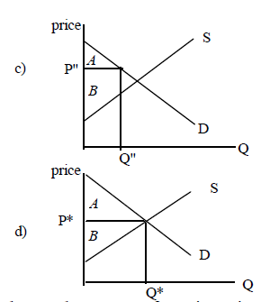
Example 4:
Graph (c) shows the total producer and consumer surplus in a pizza market where Q” is sold at a price P”. Consumer surplus is A, and producer surplus is B. The total welfare from the good is A+B. This is the value of the good to buyers minus the cost to sellers.
The total surplus will be maximized (under most conditions) if the free market equilibrium prevails. In graph (d) the sum of producer and consumer surplus is A+B, and total welfare is a maximum.

Slide 15
There is a direct (positive) relationship between equilibrium price and the amount of producer surplus.
Given the supply curve, lower prices reduce producer surplus; higher prices increase it.

Slide 16
Economic Efficiency
All markets that have downward-sloping demand curves and upward-sloping supply curves yield consumer and producer surplus.
At the equilibrium level we obtain economic efficiency.
Economic Efficiency is sum of Productive Efficiency and Allocative Efficiency.
Productive Efficiency is achieved when competition forces producers to use the best techniques and combinations of resources in growing and selling that commodity.
i.e. Production costs of each level of output are minimized.

Slide 17
Allocative efficiency is achieved because the correct quantity of output is produced relative to other goods and services.
Demand Curve represents Marginal Benefits
Supply Curve represents Marginal Costs
At equilibrium D = S implies MB = MC
Also the demand function shows Maximum Willingness to pay for the where as the supply function shows Minimum Acceptable price for the good.

Slide 18
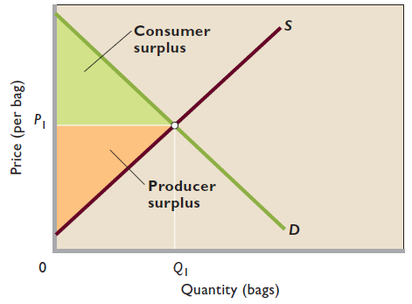
Economic Efficiency is maximum combined consumer and producer surplus.
At quantity Q1 the combined amount of consumer surplus, shown as the green triangle, and producer surplus, shown as the orange triangle, is maximized.
Efficiency occurs because, at Q1, maximum willingness to pay, indicated by the points on the demand curve, equals minimum acceptable price, shown by the points on the supply curve.

Slide 19
Summary of CS, PS and EE
• Consumer surplus is the difference between the maximum price that a consumer is willing to pay for a product and the lower price actually paid.
• Producer surplus is the difference between the minimum price that a producer is willing to accept for a product and the higher price actually received.
• At the equilibrium price and quantity in competitive markets, marginal benefit equals marginal cost, maximum willingness to pay equals minimum acceptable price, and the total of consumer surplus and producer surplus is maximized. These individual conditions define Allocative efficiency.

Slide 20


Mathematical Interpretation
The formula for finding the area under the curve y = f(x) between the points x = a and x = b is given by the definite integral,
Consumer surplus is the difference between the price consumers are willing to pay for a good or service and the actual price.
Producers surplus is the difference between what
producers are willing and able to supply a good for and the price they actually receive.

Slide 21
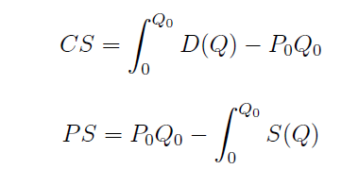
Assuming that the equilibrium price is P0 and the equilibrium quantity is Q0 then the formulas for consumer surplus and producer surplus are
where D(Q) represents the demand function written in terms of Q and S(Q) represents the supply function written in terms of Q.

Slide 22
Case Study-1 Economics @ Florida
On September 28, 2003, Hurricane Juan hit Nova Scotia, destroying many homes and cutting electricity throughout the province. It was weeks before many Nova Scotians had power restored, and many businesses, especially agricultural businesses, were badly affected.
Hurricane Juan was one of the most powerful and damaging hurricanes to ever affect Canada. But as bad as it was, Juan was only a category 1 hurricane (with gusts measured at 129 kilometres per hour). Imagine, then, what it must have been like to be in Florida on August 21, 1992, when Hurricane Andrew hit. Andrew was a category 5 hurricane, with winds gusting at 284 kilometres per hour. It carved through Florida, causing as much as $26.5 billion in damage.
Florida quickly began rebuilding, with the help of thousands of construction workers who temporarily moved there. These construction workers were not motivated mainly by sympathy for Florida residents. They were lured by the high wages available there—and they took home billions of dollars.

Slide 23
But how much did the temporary workers actually gain? Certainly we should not count all the money they earned in Florida as a net benefit. For one thing, most of these workers would have earned something—though not as much—if they had stayed home.
In addition to this opportunity cost, the temporary move to Florida had other costs: the expense of motel rooms and of transportation, the wear and tear of being away from families and friends.
Clearly the workers viewed the benefits as being larger than the costs— otherwise they wouldn’t have gone to Florida in the first place. But the producer surplus earned by those temporary workers was much less than the money they earned.

Slide 24
Case Study-3 ‘H20-Carbon Crystal Paradox’
Essential good is cheaper than not-so-essential
Former available in abundance compared to latter which is scarce
Marginal utility and price of last unit is very little for former but very great for latter
The total utility and the consumer surplus from all the water used are far greater than the total utility and the consumer surplus from all the diamonds purchased.
Demand depends on marginal utility and not on total utility.
The excess of the market price of the commodity over the marginal cost of production will estimate the producer surplus.

Slide 25

Sample footer

Slide 26
Thanking
BITS PILANI, K.K.BIRLA GOA CAMPUS
Under the aegis of
Department of Economics
Dr. Mridula Goel (HOD)
Dr. Debashish Pattanaik
Dr. Aswini Kumar Mishra
Dr. Kubendran N.
Dr. Indranil De
Ms. Ambili K.
Mr. Swagat Kishore Mishra

